Slide 1
Teach reading: change lives
Parent workshop: Phonics and early reading in Reception, Phase 2
(Autumn 1)
Notes:
For this presentation, you will need to download and print out the following resources and information for parents:
Phase 2 grapheme information sheet – Autumn 1
the parent handout ‘Your child’s reading journey – Reception Autumn term’
the Phase 2 and 3 grapheme mat
the Little Wandle Progression overview
‘Phase 2 tricky words: Reception Autumn term – Information for parents and carers’ – or parents can access this in the ‘For parents’ area of the Little Wandle website.
You will need a flipchart and access to the Little Wandle and Collins websites.
You may also wish to have a copy of the Little Wandle Glossary to hand (in Getting started/Teaching).

Slide 2


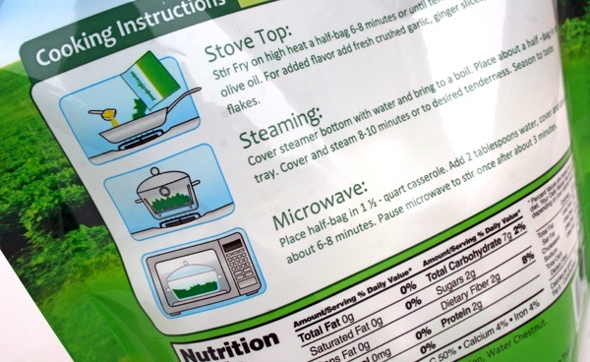
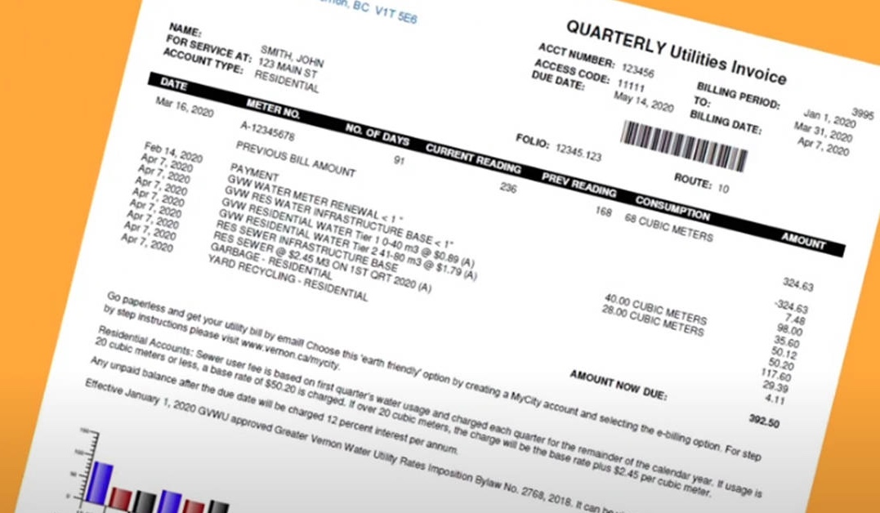
How many times have you already read today?
Notes:
Slide purpose:
To help parents see the value of reading by getting them to reflect on their own reading experiences
Suggested script:
Just think about how many times you have already read things today. More than ever, we are surrounded by text and reading is a vital skill.
We want all of our children to become confident readers who can navigate the world of reading around them.

Slide 3

Phonics

Slide 4
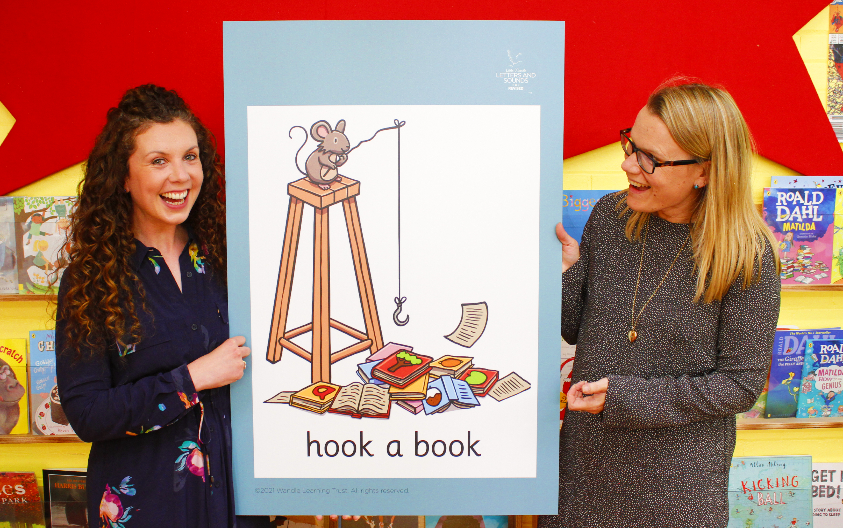
Little Wandle Letters and Sounds Revised
Our school has chosen
Little Wandle Letters and Sounds Revised as our Systematic Synthetic Phonics (SSP) programme to teach early reading and spelling.
Notes:
Slide purpose:
To inform parents that all schools must teach phonics in Reception, but explain your school's choice of SSP
Suggested script:
The National Curriculum specifies that all schools must teach children to read using phonics in Reception.
Read the slide.

Slide 5
Phonics is:
making connections between the sounds of our spoken words and the letters that are used to write them down.
Notes:
Slide purpose:
To provide a simple definition of phonics
Suggested script:
So what is phonics?
Read the slide.
It sounds complicated but it really isn’t!
Let's learn some important words that will help you understand phonics ...

Slide 6
Terminology
Phoneme
Blend
Grapheme
Segment
Digraph
Trigraph
Notes:
Slide purpose:
To give simple definitions of key terminology
Notes:
Explain what each word means – use the Glossary to help.

Slide 7
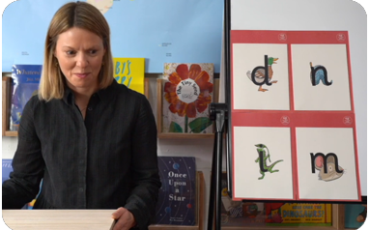
This term we are teaching Phase 2
These are the first group of letters and sounds your child will learn.
We start teaching from week 2 of Reception.
The lessons are fun, interactive, engaging and have been designed to gradually build over time.
Notes:
Slide purpose:
To introduce Phase 2
Notes
Read the slide.

Slide 8
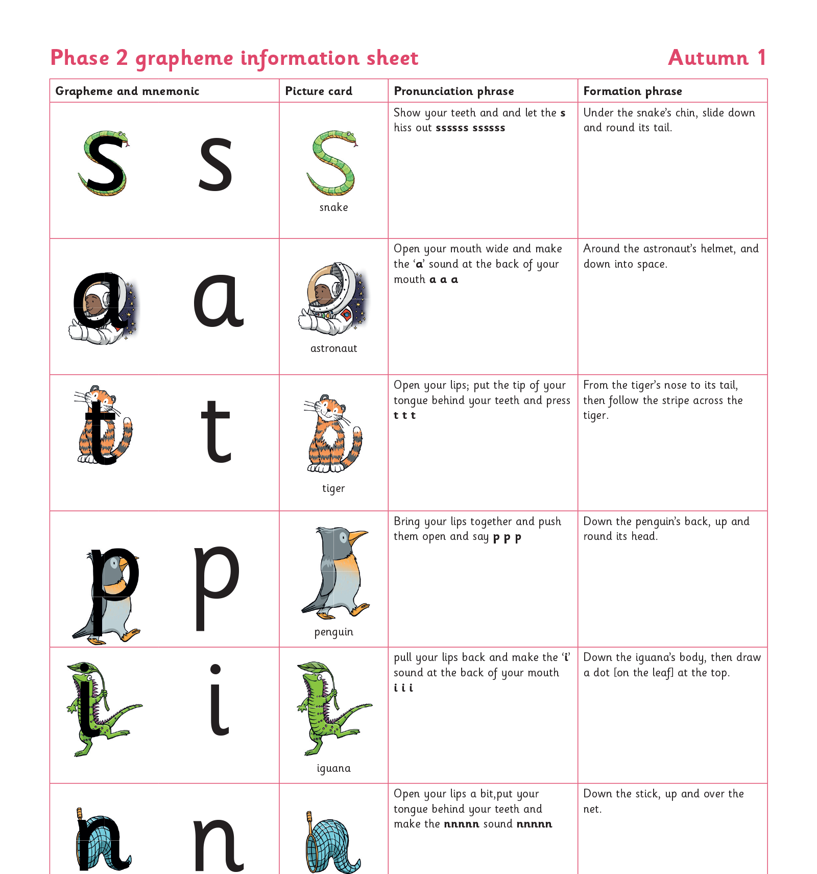
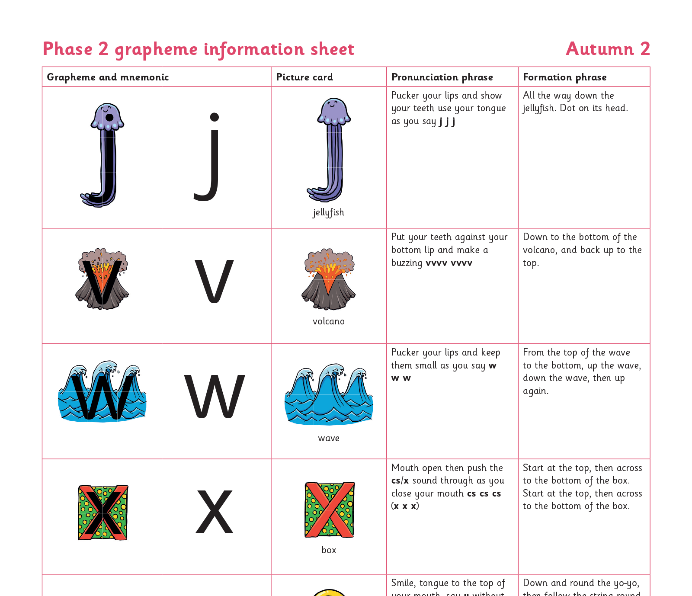
We teach Phase 2 in this order
Notes:
Slide purpose:
To provide an overview of the Phase 2 sounds
Suggested script:
We usually teach four new sounds a week and have a review lesson on a Friday.
You will get a list of the sounds that we are learning to have at home. This will help you with letter formation (handwriting) and pronunciation.
Give the Phase 2 grapheme information sheet for Autumn 1 to parents.

Slide 9
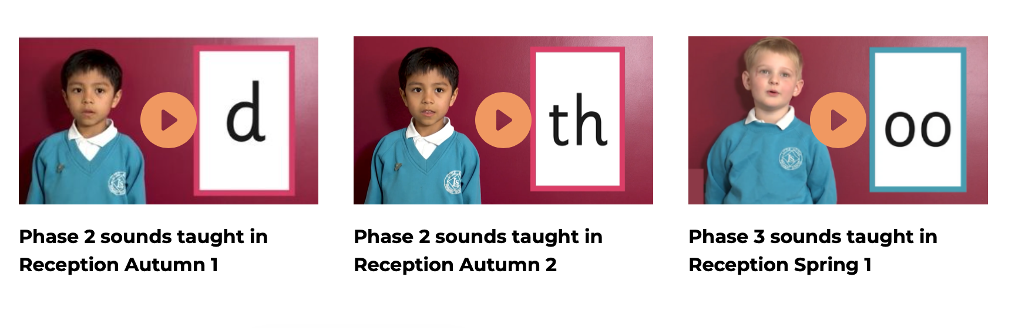
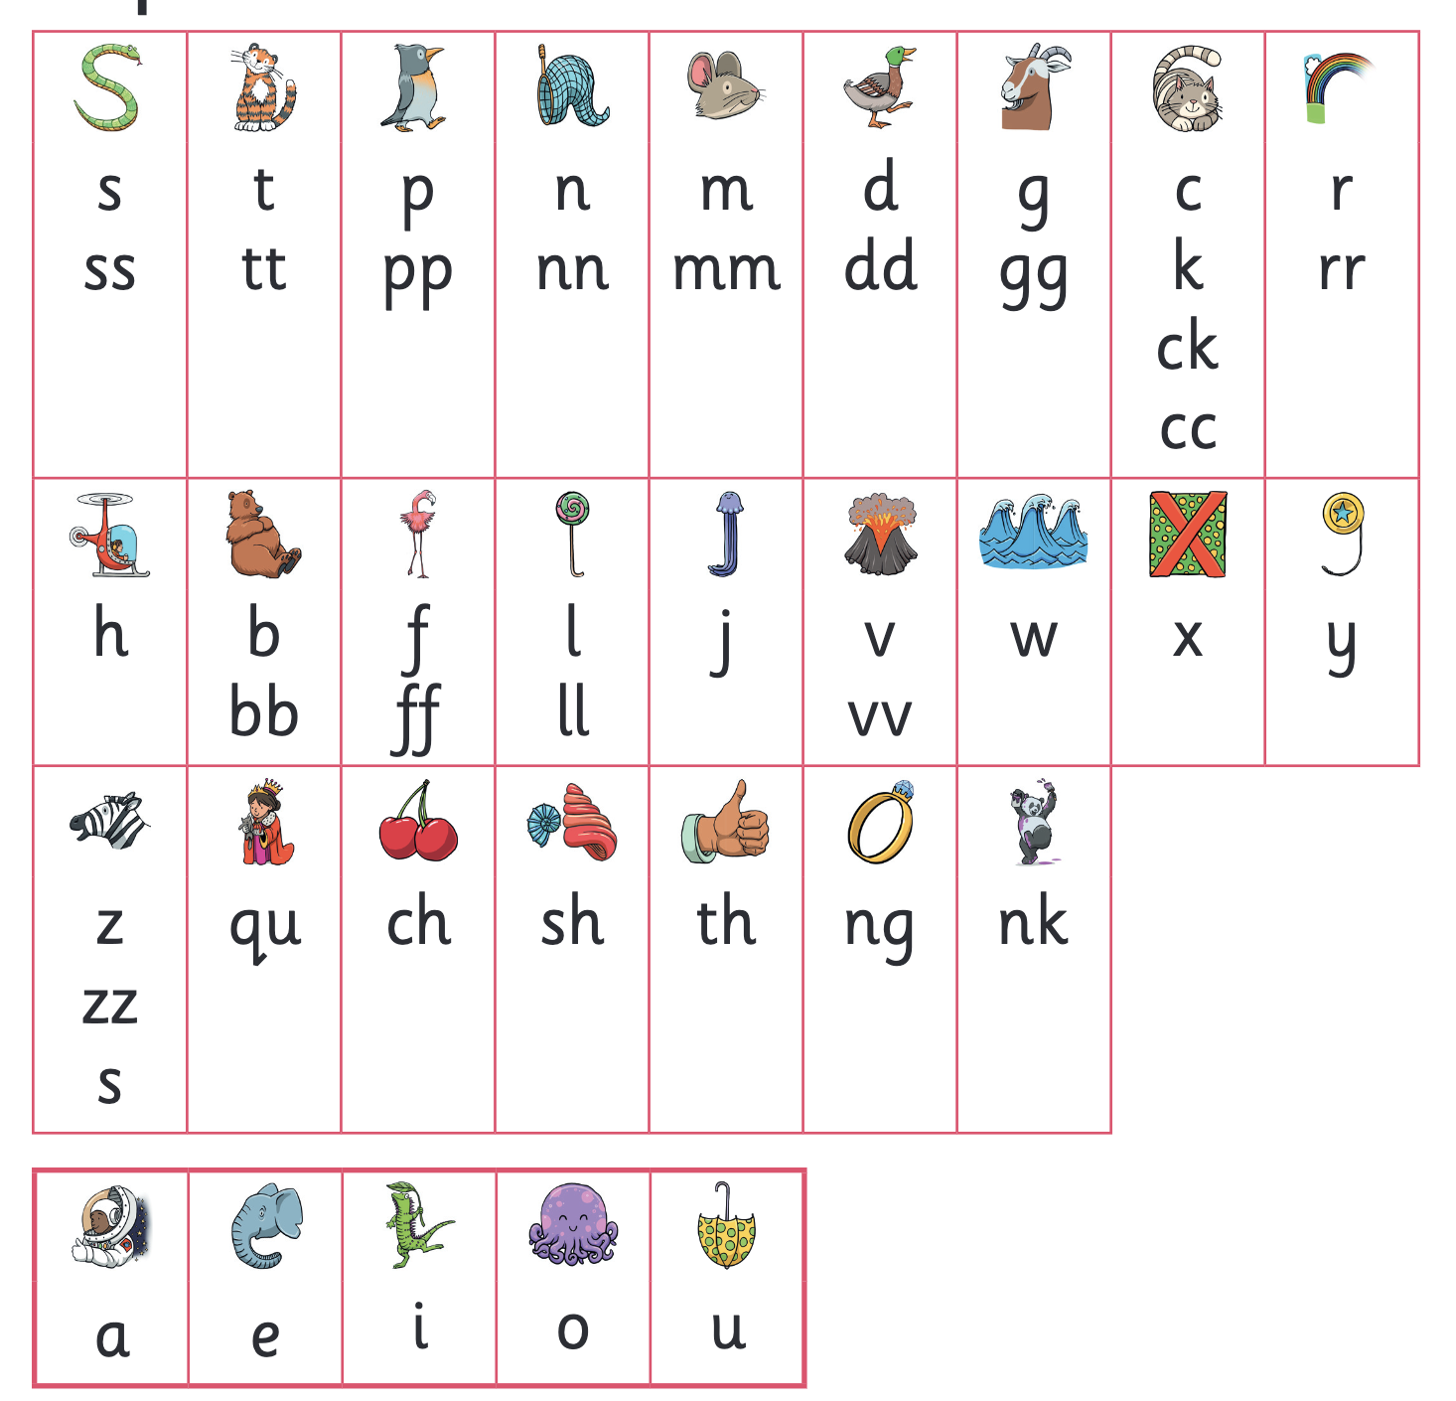
Let’s say the Phase 2 sounds
Notes:
Slide purpose:
To practise the Phase 2 sounds
Notes
Give out the parent handout and the Phase 2 and 3 grapheme mat.
Play the videos/teach the parents to say the Phase 2 sounds: https://www.littlewandlelettersandsounds.org.uk/resources/for-parents/
Show parents where to access these videos in the ‘For parents’ area of the Little Wandle website.

Slide 10
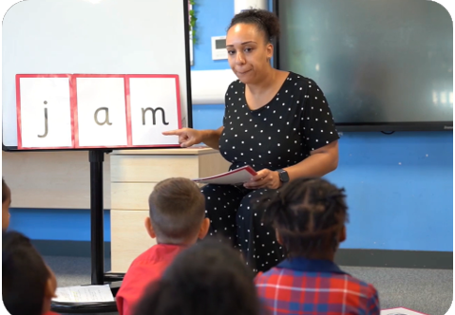
We teach blending so your child learns to read
Teacher-led blending is taught throughout Phase 2.
Our aim to is to teach every child to blend by Christmas.
We will inform you if your child needs additional practice.
Notes:
Slide purpose:
To introduce blending
Suggested script:
Teacher-led blending is teaching children how to blend, directed and demonstrated by the teacher.
It is repeated daily in the Autumn term.

Slide 11
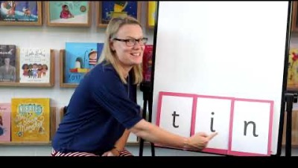
Blending to read words
Notes:
Slide purpose:
To provide an overview of blending
Suggested script:
Some children learn to blend really quickly, and others take a little longer.
If your child is finding it difficult, ask your child’s teacher for ways to help at home – playing blending games at home is so helpful!
Show parents the ‘How we teach blending’ video from ‘For parents’ area of the website: https://www.littlewandlelettersandsounds.org.uk/resources/for-parents/

Slide 12
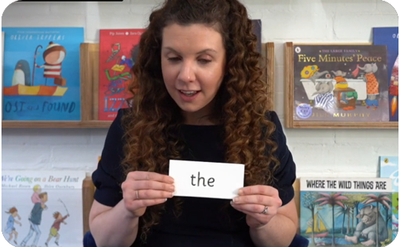
Tricky words
These words have unusual spellings e.g. he, the, was.
They are taught in a systematic way.
Children are now learning to read the Phase 2 tricky words: is, I, the, put, pull, full, as, and, has, his, her, go, no, to, into, she, push, he, of, we, me, be.
Notes:
Slide purpose:
To introduce tricky words
Notes:
Read the slide.
You may wish to give parents a copy of the document ‘Phase 2 tricky words: Reception Autumn term – Information for parents and carers'.

Slide 13
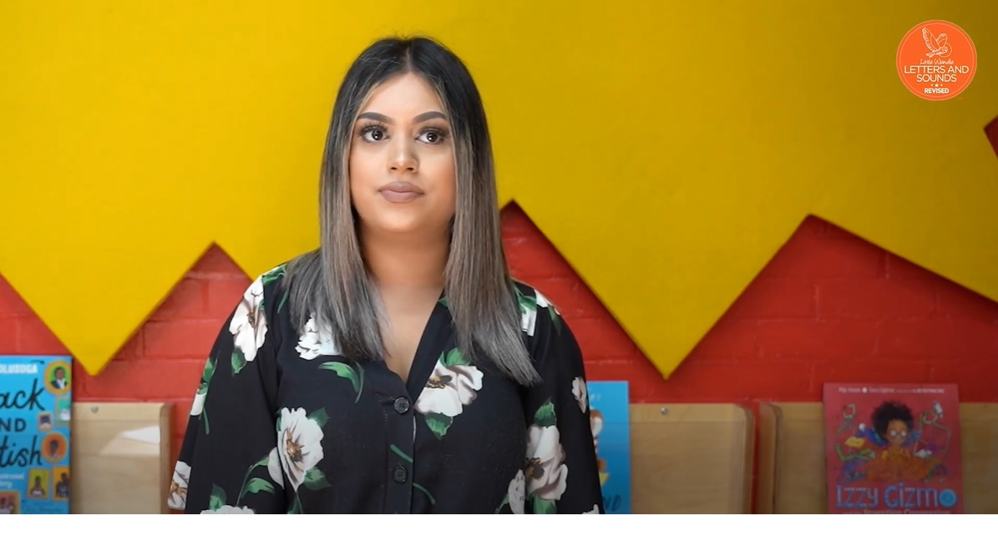
Reading tricky words
Notes:
Slide purpose:
To provide an overview of tricky words
Notes
Watch the ‘How we teach tricky words’ video on the website: https://www.littlewandlelettersandsounds.org.uk/resources/for-parents/

Slide 14
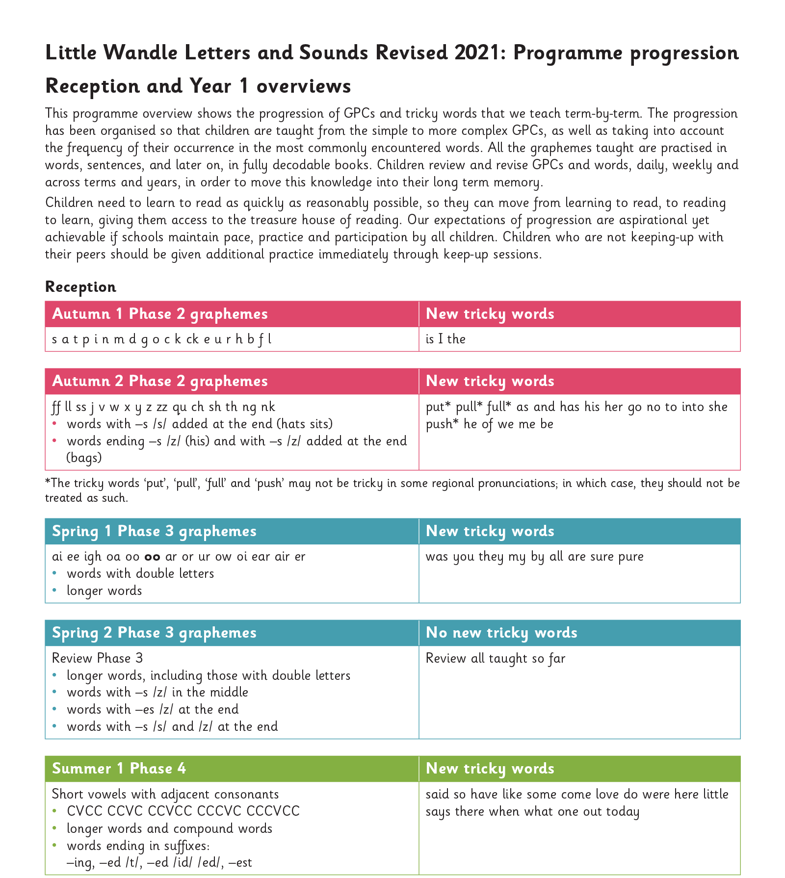
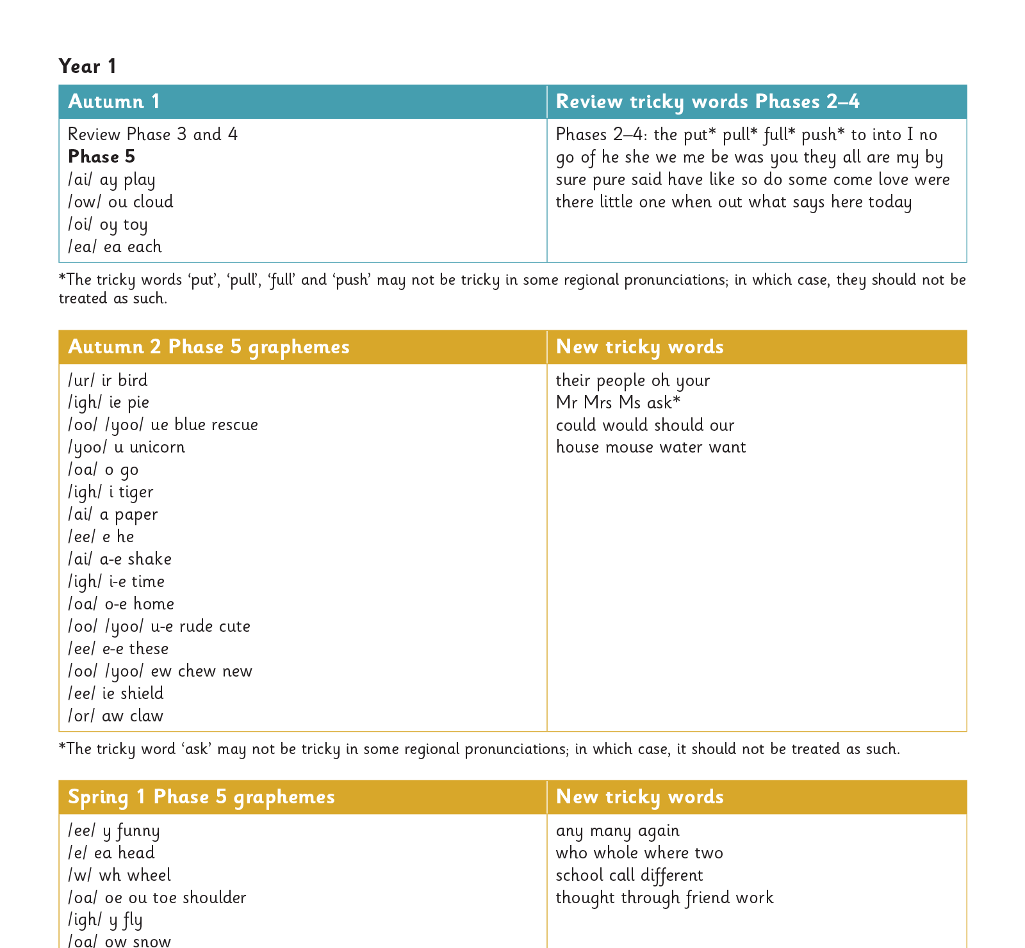
Our progression
Notes:
Slide purpose:
To provide an overview of the whole programme’s progression
Suggested script:
We will work our way through the whole Little Wandle Programme until your child can read fluently.

Slide 15
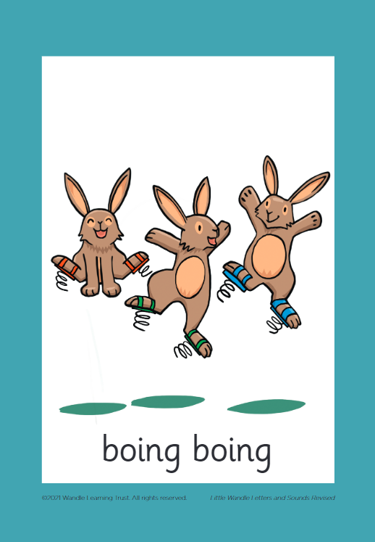



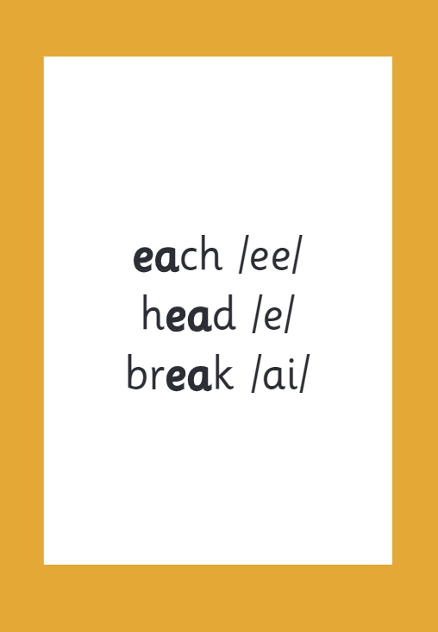

How we make learning stick
Notes:
Slide purpose:
To provide an overview of the programme’s efficacy
Suggested script:
There are specific resources for the Little Wandle Programme which the children will be very familiar with.
Each sound that we teach to begin with has either a mnemonic (like the astronaut that you can see here) or a phrase like boing-boing for ‘oi’. This helps the children recognise and remember the graphemes.
Every time we teach a new sound, we also read words during the phonics lesson that contain that new sound so that the children practise what they have learned.
We then go on to reading a sentence containing some of those words.
We have displays in the classroom and on the tables to support the children throughout the day.

Slide 16
Reading and spelling

Slide 17
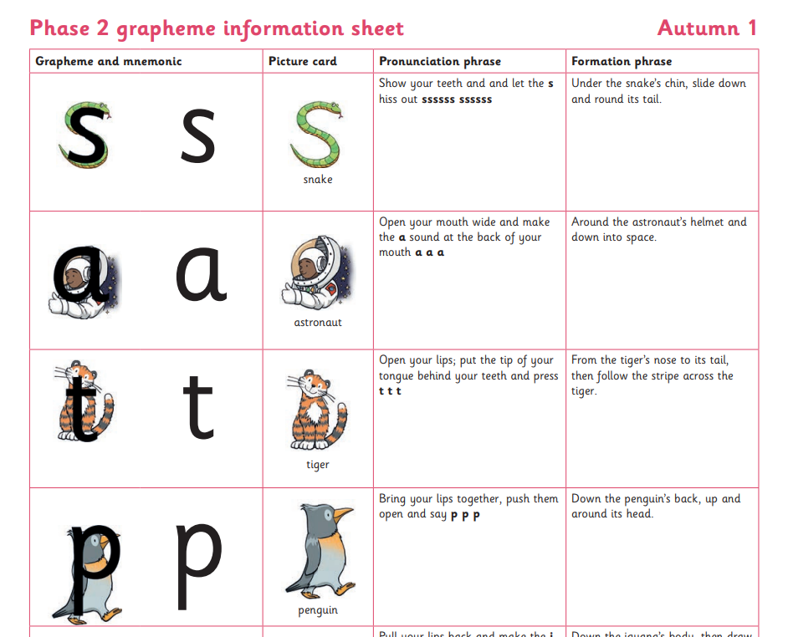

Spelling
Your child will be taught how to spell simple words, using the graphemes they have been taught.
They will practise the correct formation of letters. They will also have handwriting lessons.
Notes:
Slide purpose:
To introduce spelling
Notes:
Read the slide.
Hand out the Phase 2 grapheme information sheet for Autumn 1, which includes the formation phrases.

Slide 18

How do we teach spelling?
Say the word.
Segment the sounds.
Count the sounds.
Write them down.
Notes:
Slide purpose:
To provide an overview of spelling
Notes:
Model the process above on a flipchart for the parents to see.
Show the process with a Phase 2 word, e.g. pin, dig, hug.

Slide 19
How do we practise reading in books?
Reading practice sessions are:
timetabled three times a week
taught by a trained teacher/teaching assistant
taught in small groups
children in Reception will bring a book home by week 4 of the first half-term.
Notes:
Slide purpose:
To introduce decodable books
Suggested script:
The children read the same book three times in a week.
The first time we work on decoding (sounding out) the words, the second time we work on prosody which is reading with expression – making the book sound more interesting with our story-teller voice or our David Attenborough voice – and the third time we look at comprehension.
We read the books three times at school because we want to develop the fluency.
The more children see words, the more they begin to read them automatically without having to sound them out.

Slide 20
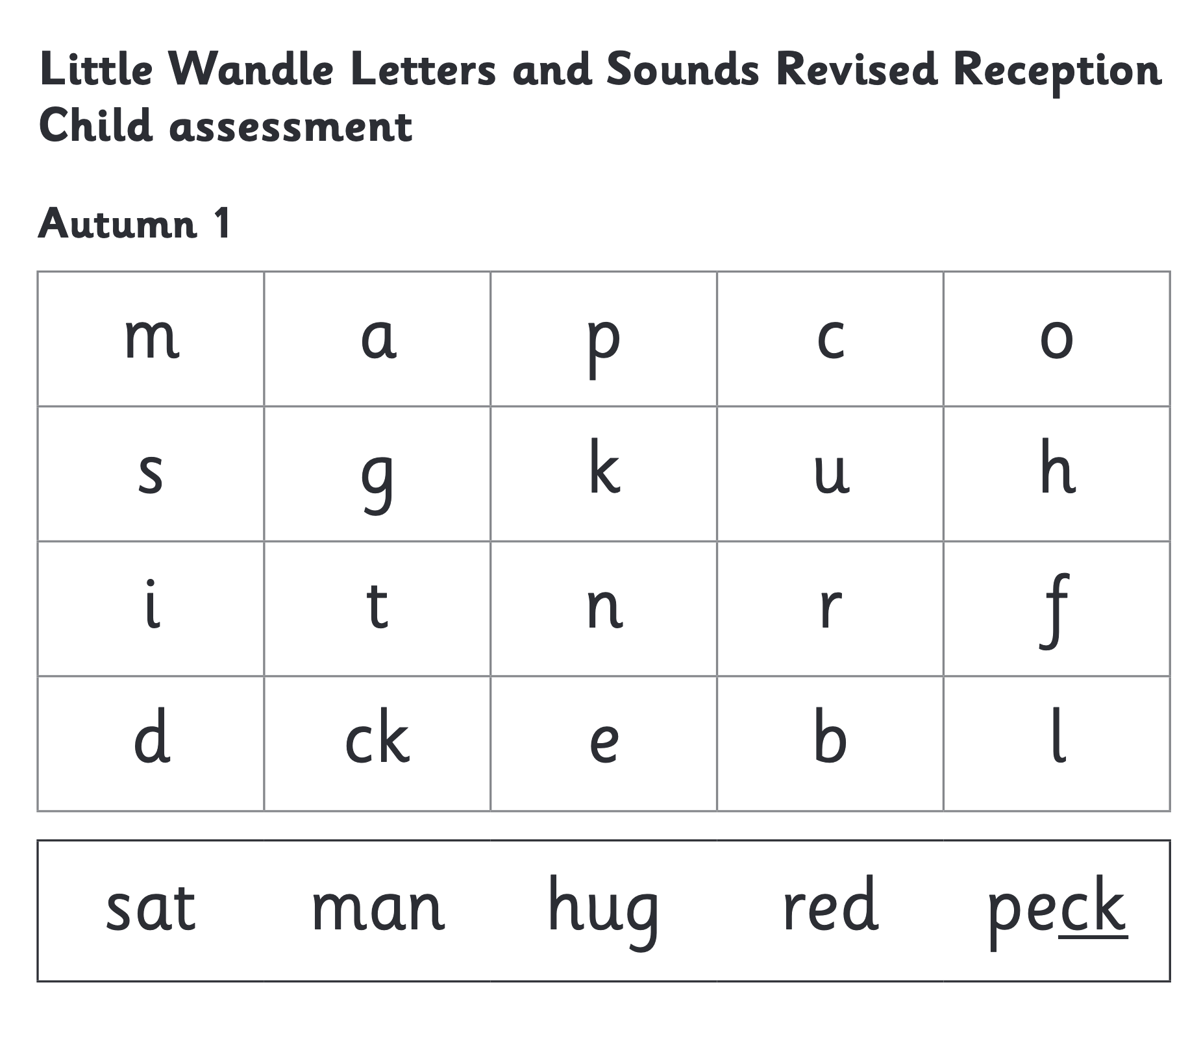
How do we find the right book for your child?
Notes:
Slide purpose:
To introduce book matching
Suggested script:
We assess your child every six weeks to check progress.
Any child who needs extra support has Daily Keep-up sessions planned for them.

Slide 21
Reading at home

Slide 22

Books going home
Notes:
Slide purpose:
To introduce the process and format for reading at home
Suggested script:
As well as the ‘learning to read’ book that your child will bring home they will also bring home a book for sharing with you.
This shared book is SO important. This is how we are going to give them the WILL to read.
Please read with your child as often as you can – at least once a day if possible.

Slide 23
Books going home
Every Thursday the children will choose a new library book.
Every Wednesday the children will bring home their reading book (which will be collected on Mondays).
Keep the books and reading record in their bags everyday so we can get in extra reading time.
Record every shared read and independent read in the reading record. The easiest way to do this is to write the dates next to the title – and just a simple comment every week such as:
These letters were confused…
Lovely reading…

Slide 24
Listening to your child read their phonics book
Your child should be able to read their book without your help.
They might sound out words and blend them before they read them fluently.
If they can’t read a word, read it to them.
Talk about the book and celebrate their success.
Notes:
Slide purpose:
To give guidance on reading the decodable book at home
Notes
Read the slide.

Slide 25
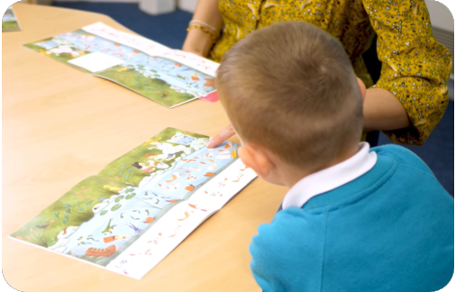
Reading a wordless books
Wordless books are invaluable as they teach reading behaviours and early reading skills to children who are not blending – yet!
Talk about the pictures.
Point to the images in the circles and find them on the page.
Encourage your child to make links from the book to their experiences.
Notes:
Slide purpose:
To give guidance on reading wordless books at home
Notes:
Read the slide.

Slide 26
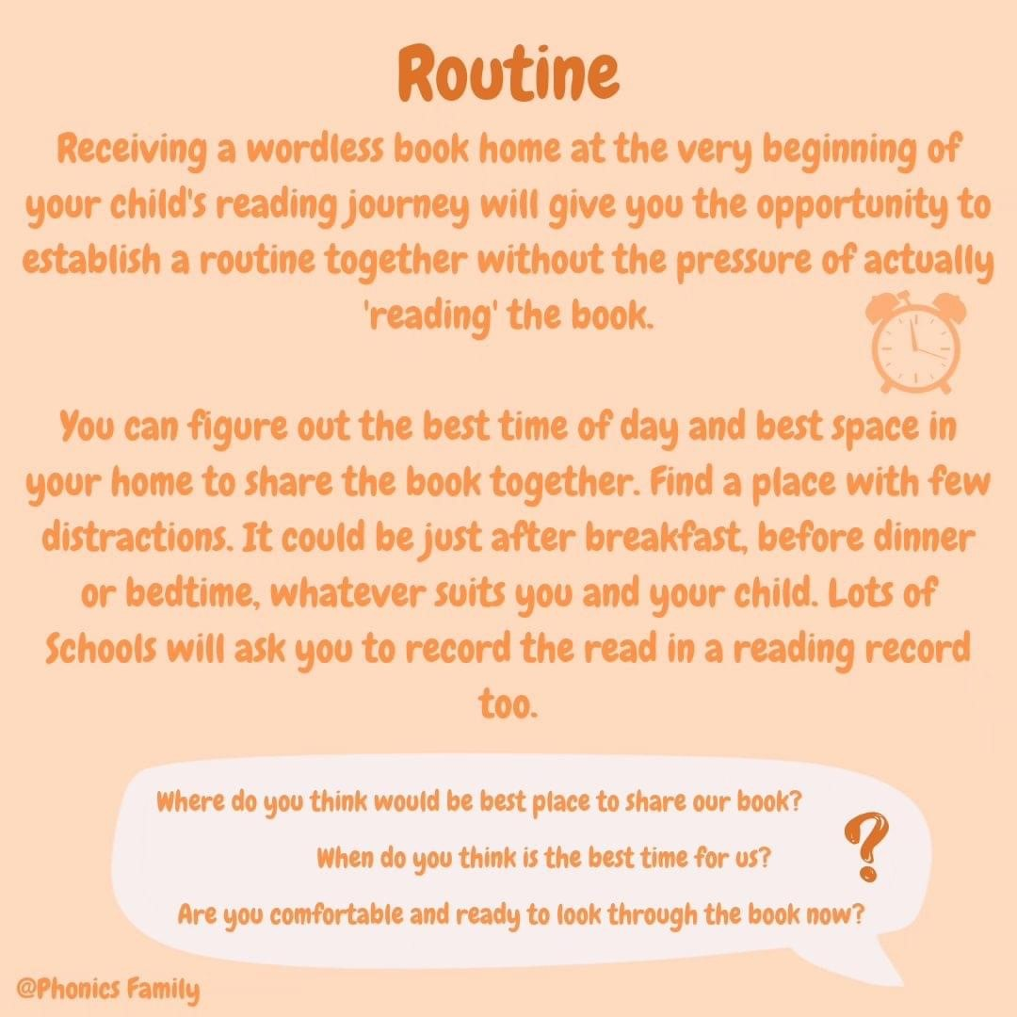

Slide 27
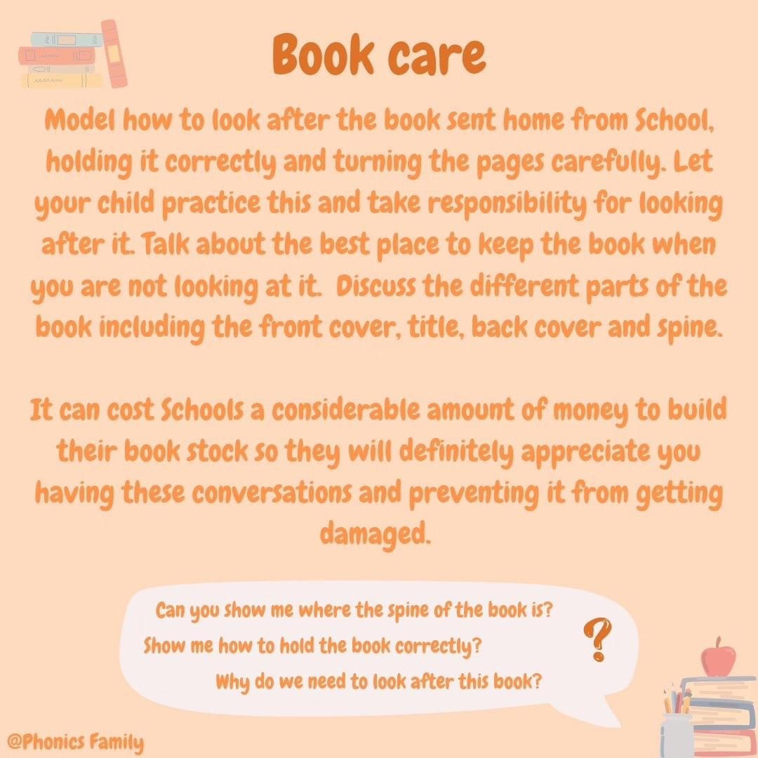

Slide 28


Slide 29
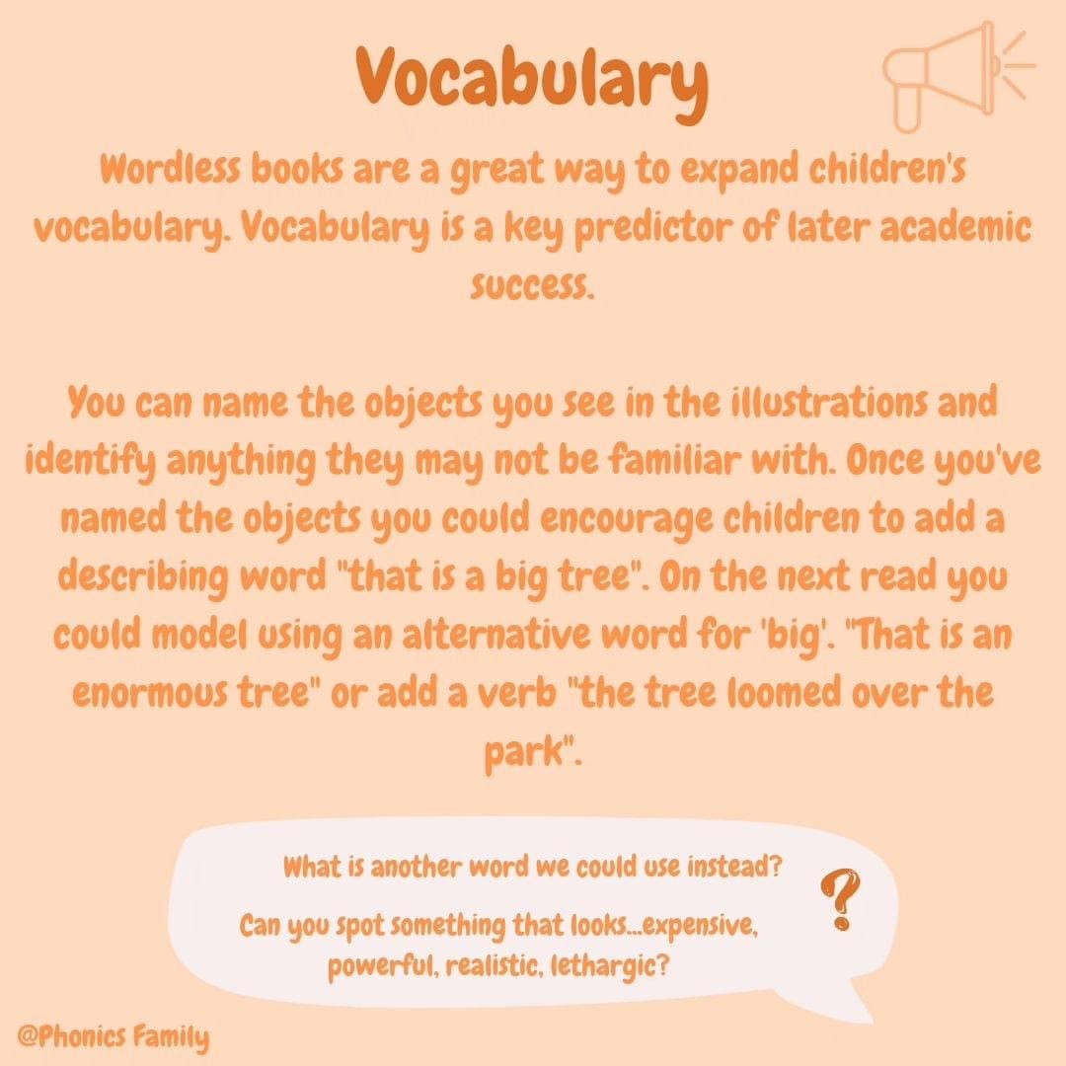

Slide 30
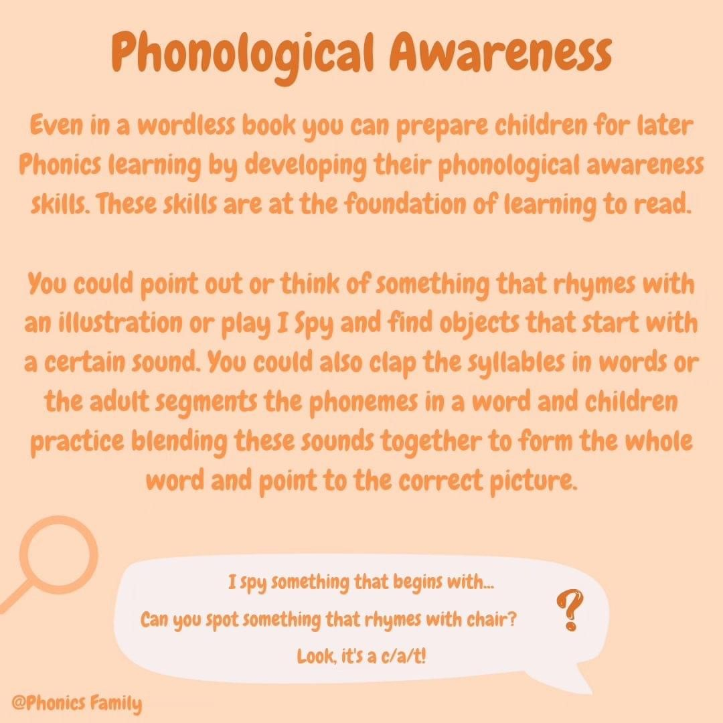

Slide 31
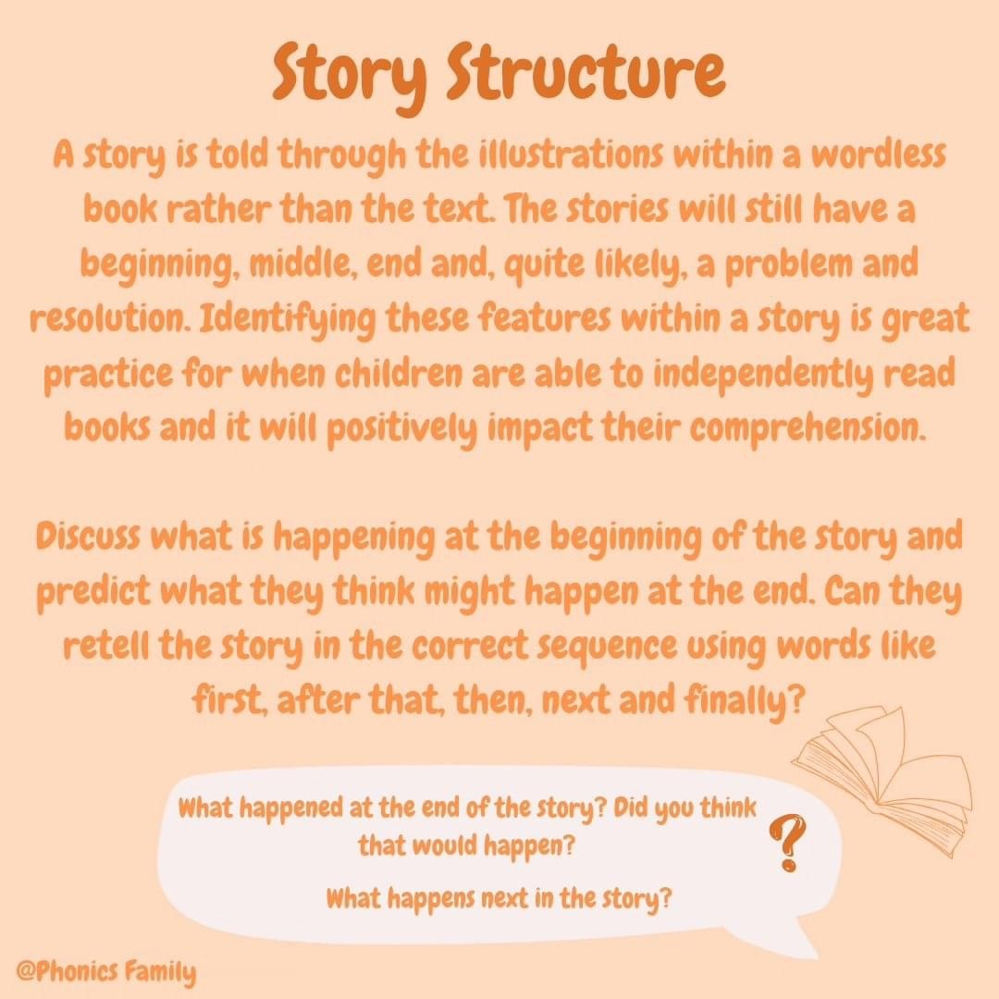

Slide 32
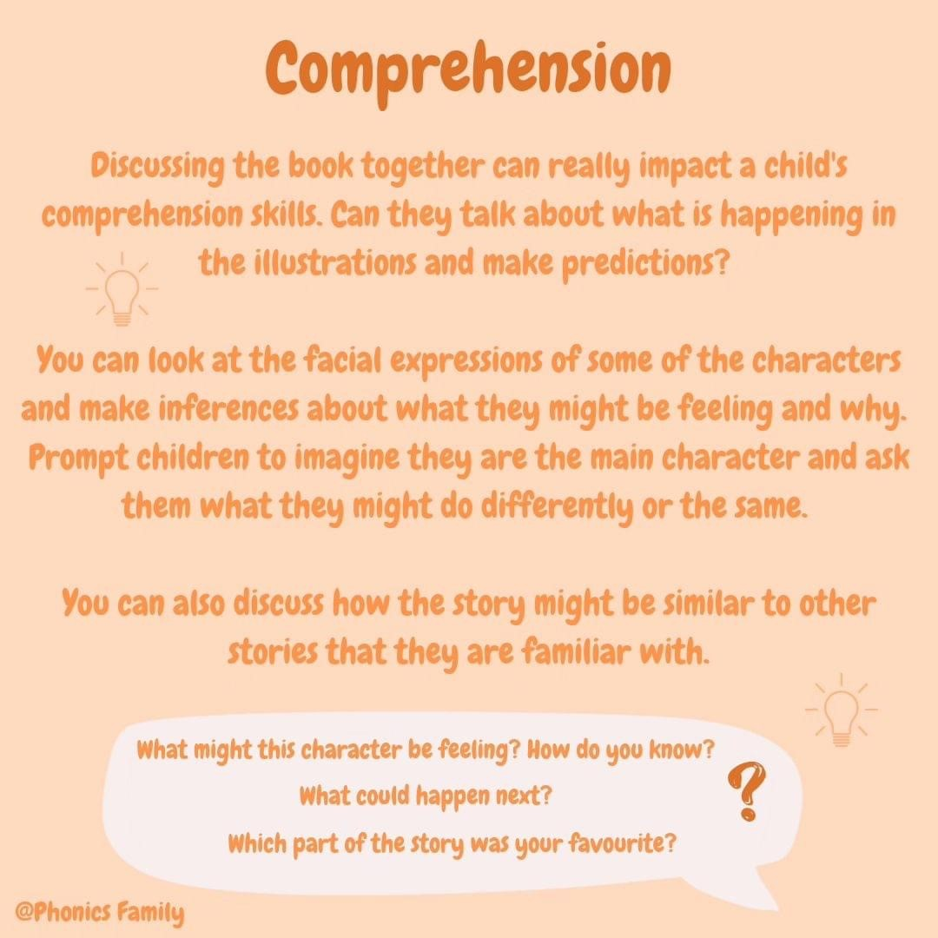

Slide 33
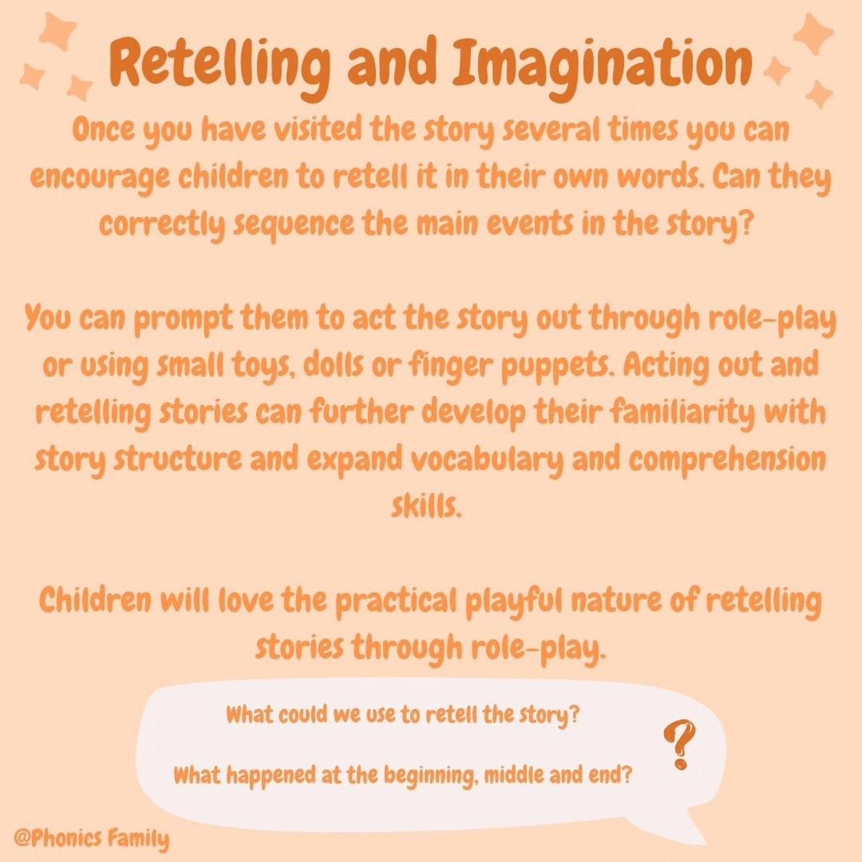

Slide 34

Read to your child
The shared book is for YOU to read:
Make the story sound as exciting as you can by changing your voice.
Talk with your child as much as you can:
  Introduce new and exciting language.
  Encourage your child to use new vocabulary.
  Make up sentences together.
  Find different words to use.
  Describe things you see.
Notes:
Slide purpose:
To give guidance on reading the shared book at home
Notes:
Read the slide.

Slide 35
Supporting your child with phonics
Notes:
Slide purpose:
To give guidance on supporting phonics learning at home
Suggested script:
It is really important that you pronounce the sounds correctly at home if you are supporting your child.
Use the videos we saw earlier for support.

Slide 36
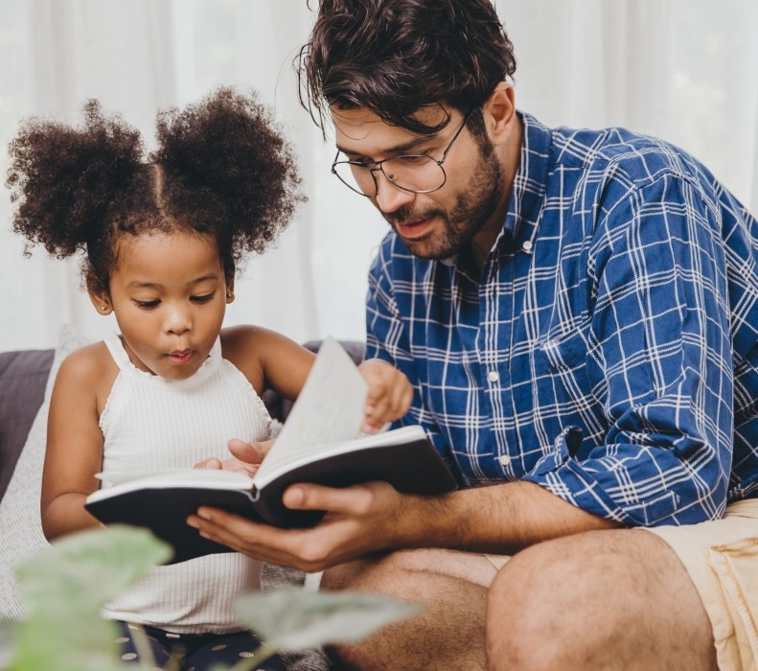
The most important thing you can do is read with your child
Reading a book and chatting had a positive impact a year later on children’s ability to…
understand words and sentences
use a wide range of vocabulary
develop listening comprehension skills.
The amount of books children were exposed to by age 6 was a positive predictor of their reading ability two years later.
Parental involvement in the development of children’s reading skills: A five-year longitudinal study (2002) Senechal, M. and Lefvre, J
Notes:
Slide purpose:
To summarise key takeaways
Suggested script:
Celebrate your child’s success at school.
Make time for reading at home!

Slide 37
One of the greatest gifts adults can give is to read to children
Carl Sagan
Notes:
Slide purpose:
Key takeaways/final message
Notes:
Read the quote.

